Slide 1


Teaser Interview
INTERNATIONAL AGENCY FOR RESEARCH ON CANCER LYON - FRANCE
e-SMP

Slide 2

Introduction
Teaser interview
GloboDiet training:
IARC, Lyon - France
Teaser Interview

Slide 3



A short teaser interview will be used to demonstrate to the trainees how a real GloboDiet interview is to be conducted. It touches on the most important aspects of the 24-h recall
10 min teaser GloboDiet interview has been recorded
This interview will be shown and commented on afterwards
GloboDiet training:
IARC, Lyon - France
Teaser Interview

Slide 4

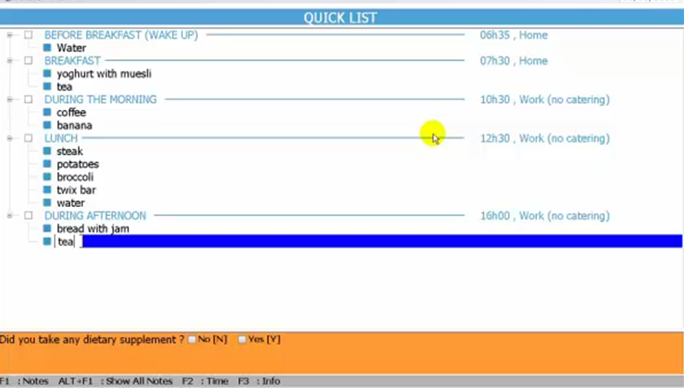
GloboDiet training:
IARC, Lyon - France
Teaser Interview

Slide 5
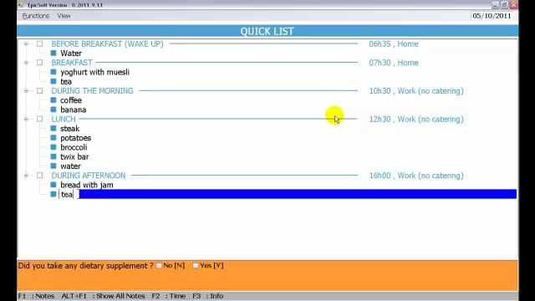
GloboDiet training:
IARC, Lyon - France
Teaser Interview

